Slide 1
Hydrogen Strategy of the Czech Republic
Petr Mervart
Plenipotentiary of the Minister of Industry and Trade for Hydrogen Technologies
8.2.2022

Slide 2
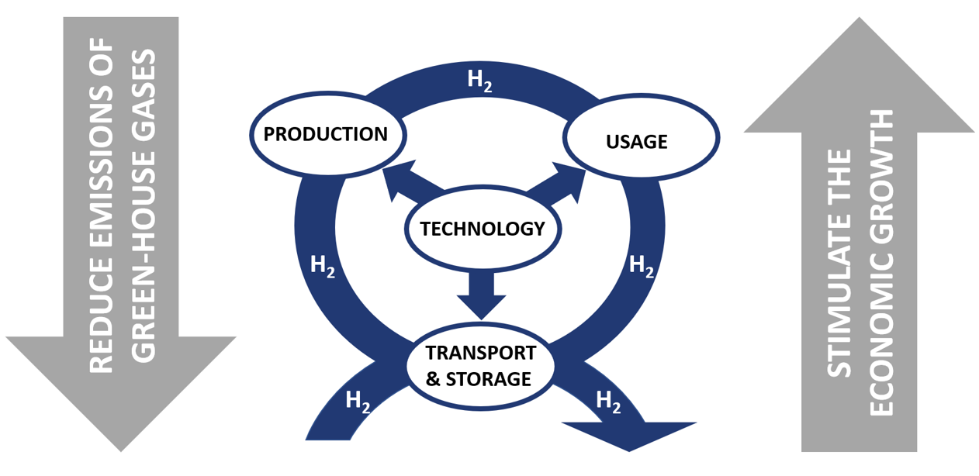
Two goals and four pillars of the strategy

Slide 3
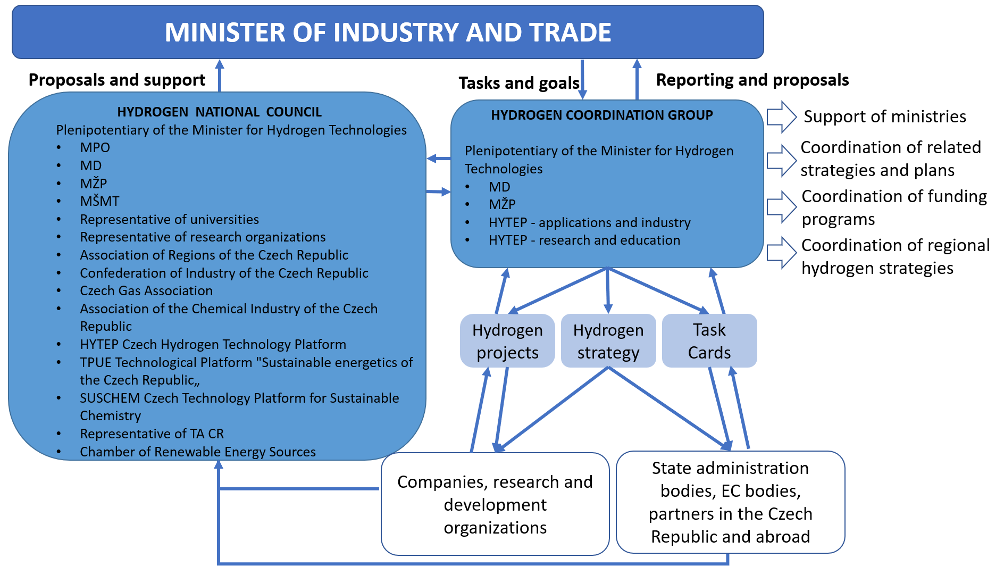
Two managing bodies

Slide 4
Roles of the Ministry of Industry and Trade
Hydrogen conferences and workshops
Funding programs
Hydrogen project portfolio (PROH2)
Regulatory and legislative proposals
Update of the hydrogen strategy

Slide 5
Hydrogen conferences and workshops
12
11
1
MSV Czech hydrogen MPO
Brno technologies
Hydrogen Student work Universities
at universities opportunities
10
2
Hydrogen Hydrogen Association
Valleys in regions of regions
3
Hydrogen R&D
Days cooperation Hytep
with Germany
9
8
4
Clean Mobility Mobility MŽP
Loučeň
7
5
Hydrogen in Hydrogen transport ČPS
Gas Industry and distribution
6
Hydrogen Evaluation National Council of the Czech MPO
meeting Hydrogen Strategy

Slide 6
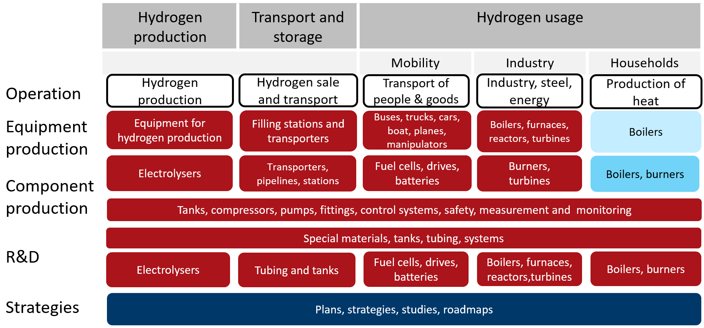
Funding programs
Doprava 2020+
Théta
Trend
Prostředí pro život
Delta 2
Modernizační fond
Inovační fond
Fond spravedlivé transformace
The Country for the Future
IPCEI
OP TAK
IROP
OP Doprava

Slide 7
Hydrogen project portfolio (PROH2)
Framework for prioritization of integrated project

Slide 8
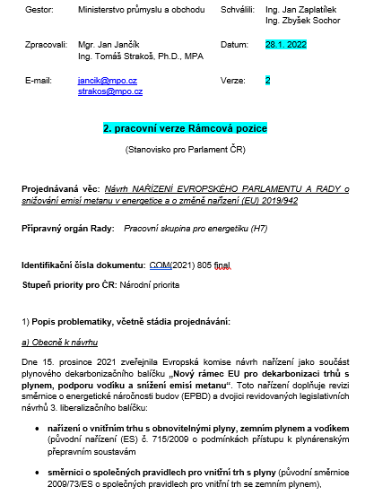
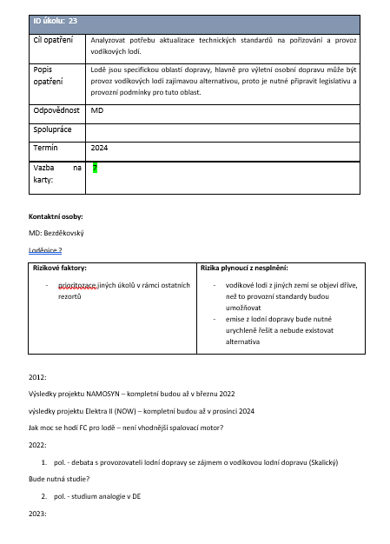
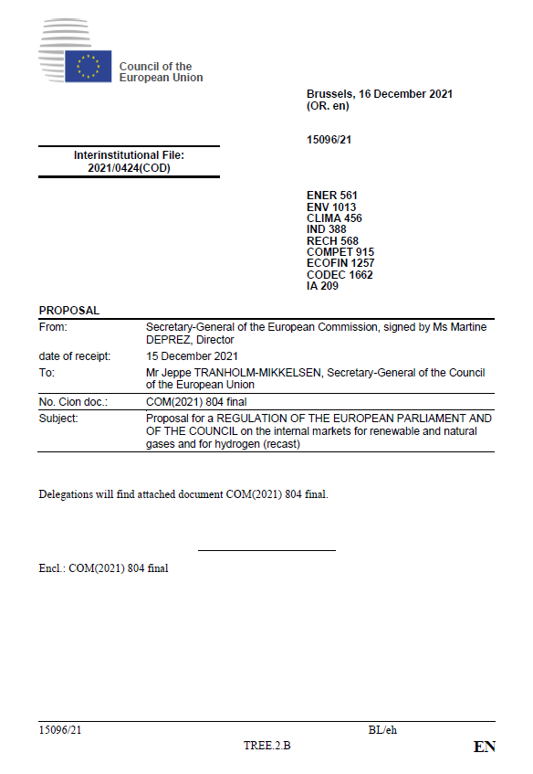
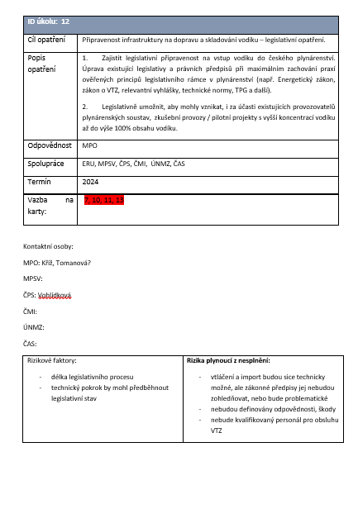
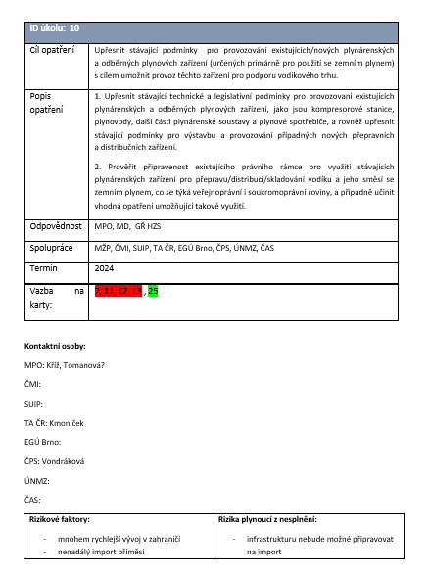
Regulatory and legislative proposals

Slide 9
Update of the hydrogen strategy

Slide 10
Petr Mervart Plenipotentiary of the Minister of Industry and Trade for Hydrogen Technologies mervart@mpo.cz Ministry of Industry and Trade Czech Republic

